Slide 1

Phishing Unmasked: Protecting Yourself Online
Phishing remains a pervasive threat in the digital landscape. It accounts for a significant percentage of data breaches, with global losses running into billions annually. This presentation will equip you with the knowledge to recognize and avoid common online scams, safeguarding your personal and financial information.

Slide 2




Understanding Phishing Attacks
Phishing refers to deceptive attempts by cybercriminals to trick individuals into divulging sensitive information or installing malware. Attackers often impersonate trusted entities like banks, government agencies, or tech support to gain your confidence.
Email Phishing
Smishing
Common deceptive emails
Phishing via SMS messages
Vishing
Goals
Voice phishing calls
Steal credentials or install malware

Slide 3
Spotting Phishing Emails
Phishing emails often contain tell-tale signs. Always be vigilant for these red flags before clicking any links or downloading attachments.
Suspicious Sender
Look for slight misspellings in the domain, such as "amaz0n.com" instead of "amazon.com."
Generic Greetings
Emails addressing you as "Dear Customer" rather than by your name often indicate a bulk phishing attempt.
Urgent or Threatening Language
Phrases like "Account suspended, act now!" are designed to create panic and bypass rational thought.
Poor Grammar/Spelling
Inconsistencies and errors in language are common indicators of a scam email.
Unexpected Attachments/Links
Always hover your mouse over links to reveal the true URL before clicking. Be cautious of unsolicited attachments.

Slide 4
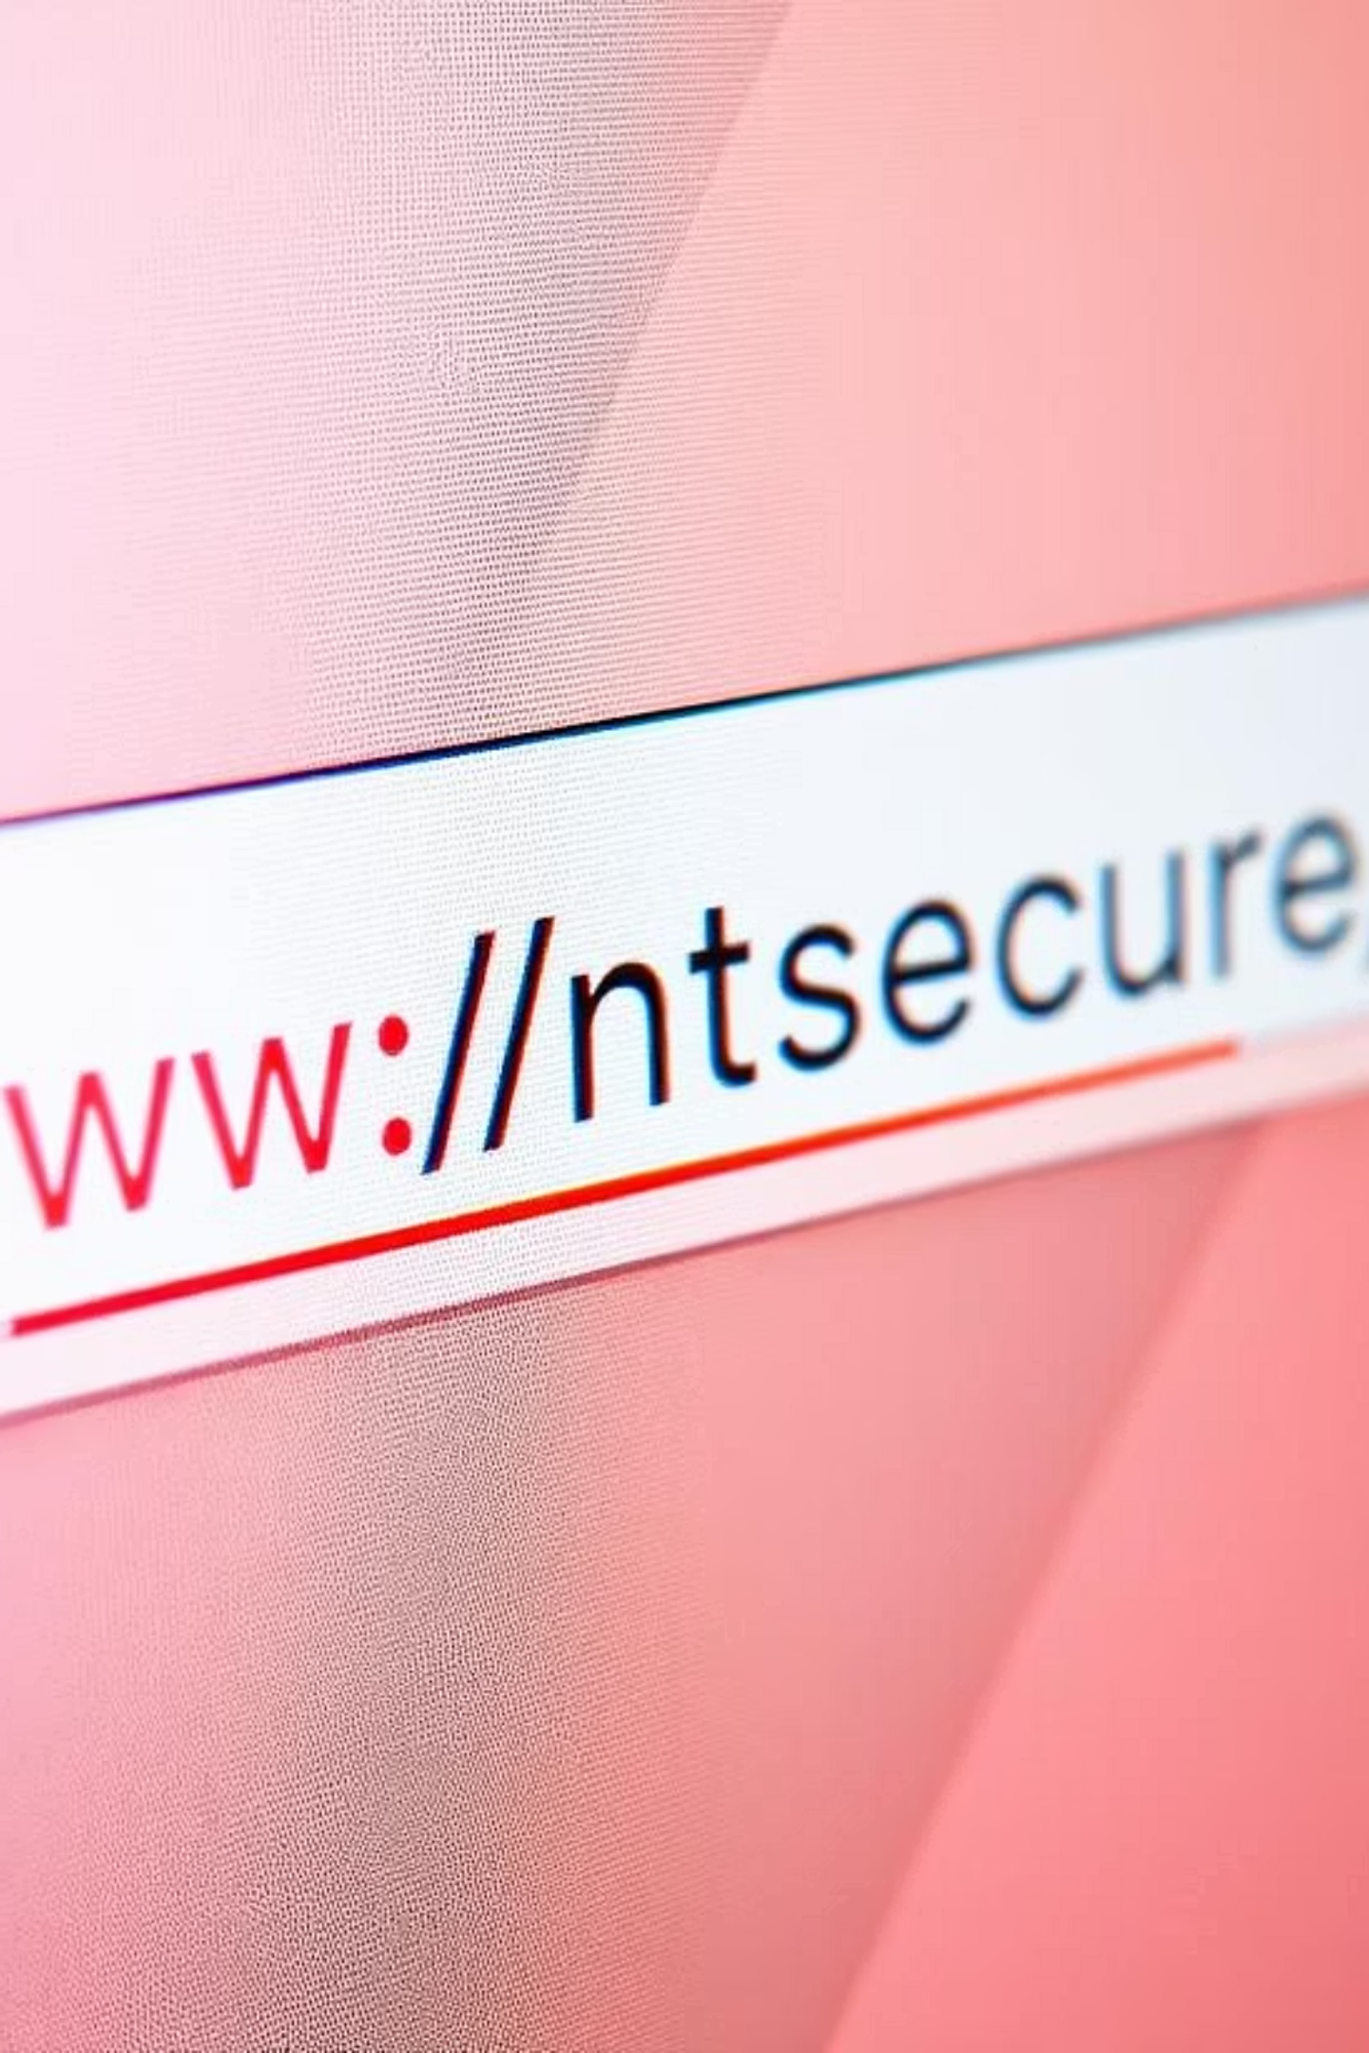
Identifying Fake Websites
Attackers often create counterfeit websites that mimic legitimate ones. Knowing how to identify these fakes is crucial for protecting your information.
URL Discrepancies: Check for subtle misspellings or extra words in the domain, e.g., "wellsfargo.login.net" instead of "wellsfargo.com."
No HTTPS/Padlock: A legitimate website will have "https://" at the beginning of its URL and a padlock icon, indicating a secure connection.
Poor Design/Low Quality: Blurry logos, inconsistent formatting, or outdated content can be signs of a fake site.
Sudden Pop-ups/Errors: Be wary of sites that immediately request sensitive information via pop-ups or display unexpected errors.
Browser Warnings: Pay attention to "Not Secure" warnings from your web browser (Chrome, Edge, Safari), which indicate a lack of encryption.

Slide 5




Deceptive Social Engineering Tactics
Phishing leverages social engineering, manipulating individuals to perform actions or divulge confidential information. These tactics exploit human psychology.
Urgency/Fear
Authority Impersonation
"Your account will be locked in 24 hours!"
"CEO requires immediate wire transfer" (Business Email Compromise)
Curiosity/Greed
Familiarity/Sympathy
"Click here for your lottery winnings!"
Pretending to be a friend or exploiting charitable impulses.

Slide 6
Best Practices: Your Digital Defense
Building a robust digital defense involves implementing several key practices that significantly reduce your vulnerability to phishing attacks.
Enable Multi-Factor Authentication (MFA): MFA blocks 99.9% of automated attacks by requiring a second verification method.
Use Strong, Unique Passwords: Combine uppercase, lowercase, numbers, and symbols. Consider a password manager.
Verify Sender Directly: If suspicious, contact the sender via a known, legitimate phone number, not by replying to the email.
Report Suspicious Emails: Forward phishing attempts to your IT department or relevant authorities like the FTC or Anti-Phishing Working Group.
Hover Before Clicking: Always inspect the full URL by hovering your mouse over links before clicking.

Slide 7


Real-World Phishing Examples & Quick Quiz
Understanding real-world cases helps illustrate the impact of phishing. These examples highlight the evolving nature of attacks.
2020 Twitter Bitcoin Scam
Quick Quiz: Is This a Phishing Email?
High-profile accounts, including those of Elon Musk and Barack Obama, were compromised via spear phishing, promoting a fake Bitcoin giveaway.
Which of the following email addresses is most likely to be from a legitimate source if you bank with "SecureBank"?
securebank.update@gmail.com
support@securesbank.com
Business Email Compromise (BEC)
no-reply@securebank.com
Companies lost billions to BEC scams where attackers impersonate executives to trick employees into making wire transfers.
Answer: 3 (Legitimate domain, common "no-reply")

Slide 8

Stay Vigilant, Stay Secure
Phishing threats are constantly evolving, making continuous learning and vigilance essential. Remember, you are the first and most critical line of defense against these cyber threats.
Implement security best practices today: MFA, strong passwords, and careful link verification.
Report suspicious activity: Your actions protect not only yourself but also contribute to a safer online environment for everyone.

Slide 9
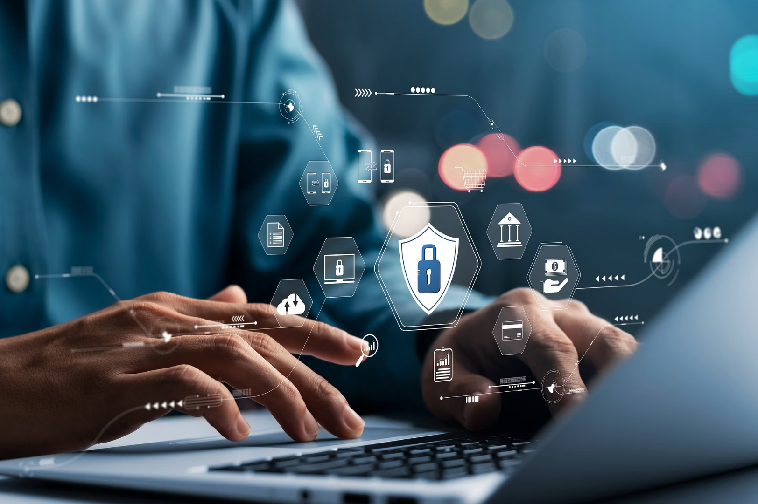
Thank YOU
Presentation by: Jiya Kumari
Email ID: verma.jiya2004jiya@gmail.com

